Slide 1

Linux On Azure Preparation Training Introduction to OSS The history of Linux & Why do we care: How OSS drives Azure consumption
Mohd Mishal
Clouds Consultant | MCT

Slide 2
Linux Foundation Certified System Administrator
Essential Commands
User and Group Management
Operations of Running Systems
Networking
Service Configuration
Virtualization
Storage Management
Speaker Information:
https://training.linuxfoundation.org/certification/lfcs
Notes:
20533D
1: Introduction to Microsoft Azure

Slide 3
Session I Agenda
Linux on Azure
Azure Data Centers
Microsoft and Open Source
Compute: IaaS, PaaS & Mobile Services
Data Services
A brief history of Linux
An understanding of core Linux terms which will be used in all sessions
Guidance to set up your personal test environment
The test environment is essential to building upon the skills taught in subsequent sessions of this program

Slide 4
Azure Datacenter
Opened first datacenter in 1989
Investment of more than $15 billion on infrastructure
Geo-replication over 500 miles apart
24x7 monitoring by US screened persons

Slide 5
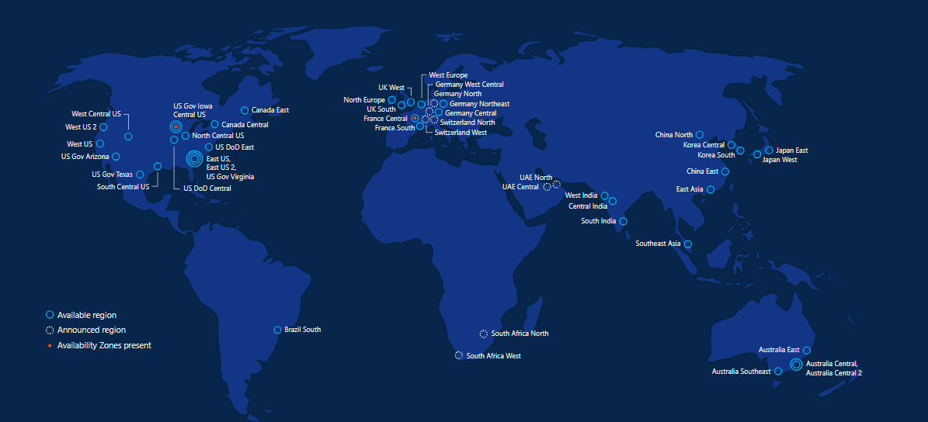
Azure regions – 50 Regions 140 Countries

Slide 6

Microsoft & Open Source

Slide 7

Inner Sourcing
In 2014, Microsoft CEO Satya Nadella directed all Microsoft engineers to "open source internally" - anyone at the company can see anyone else's code and use it as needed.
This vision is now a day-to-day reality for Microsoft engineers.
Notes:
Azure and Open Source – feedback from various UMICH departments is view that Azure is for “MSFT stack” and AWS is best for Open Source so need to emphasize our position on Open Source

Slide 8


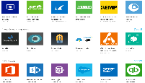






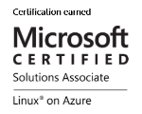
Microsoft + Open Source: Empowering Customers
Our Products
Our Offerings
Azure Marketplace
60% of all images in Azure Marketplace are based on Linux/OSS
SQL Server on Linux
Acquisition
Windows Subsystem for Linux
44% of VMs on Azure overall run Linux, and more than half of all new VMs run Linux
C:\Users\markhill> bash
44% / 1 in 3
HD Insight managed service on Linux
root@localhost: #
Run Linux on Windows natively
Our Partnerships
Our Employees
Ross Gardler President Apache SW Foundation
Brendan Burns
Co-Founder of Kubernetes
Partnership
Microsoft joins Eclipse Foundation
Partnership with the Linux Foundation for Linux on Azure certification
600 Million+
Lines of open source code
Partnership
Microsoft Open Source Hub
Jenkins project on Azure
Notes:
Notes coming soon – please check back on http://aka.ms/opensource for latest version

Slide 9












































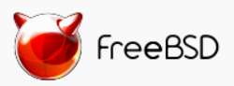

Azure is an open cloud
DevOps
Clients
Management
Applications
PaaS &
DevOps
App Frameworks
& Tools
Databases &
Middleware
Infrastructure
Notes:
P2

Slide 10
Why Linux on Azure
Our customers want it!
Roughly 1 out of 3 VMs run Linux & OSS
Enterprise grade cloud leadership
Only true hybrid cloud
Our goal is to be the most complete and open cloud

Slide 11







Linux images in the Azure Marketplace
Public Cloud
Azure Endorsed Linux Distributions
Published, maintained and supported by partners, curated & tested by Microsoft
Most endorsed distros maintain repos in each Azure region for fast updating
Standard Images
Customers can contact Linux vendor/partner for Linux support
Azure-related platform issues supported by Microsoft
Limited support for Linux issues -- from Microsoft
Premium Images
Microsoft engages the Linux vendor/partner on behalf of the customer for support
Includes updates, patches, and support through 24x7 web, email, chat and phone
Available for Red Hat Enterprise Linux and SUSE Linux Enterprise Server
Red Hat
Enterprise Linux
CoreOS
Ubuntu
OpenLogic
CentOS-based
SUSE Linux
Enterprise
Server
openSUSE
Oracle
Linux

Slide 12
Linux Distributions on Azure
CentOS
CoreOS
Debian
Oracle Linux
Red Hat Enterprise Linux
SUSE Linux Enterprise
openSUSE
Ubuntu

Slide 13
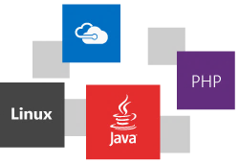

Slide 14
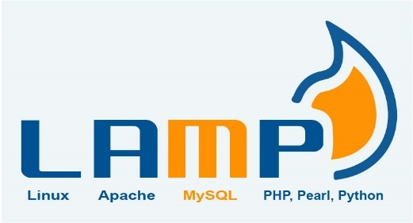

LAMP → Azure
Create an Ubuntu VM (the 'L' in the LAMP stack)
Open port 80 for web traffic
Install Apache, MySQL, and PHP
Verify installation and configuration

Slide 15
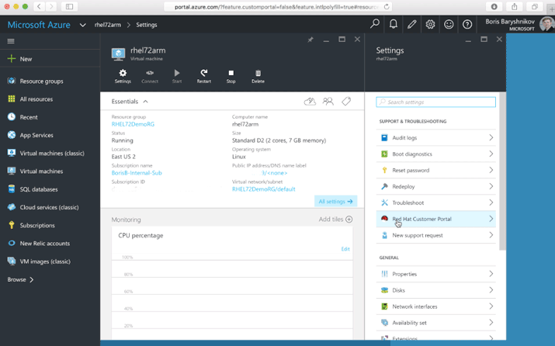
Accessing the Red Hat Customer Portal from Azure
With Azure “Pay As You Go” licensing, you can connect your subscription to Red Hat to access all Red Hat premium content and support.
Customers with existing Red Hat subscriptions may also seamlessly extend those to Azure using Red Hat Cloud Access
https://azure.microsoft.com/en-us/blog/red-hat-customer-portal-from-azure/
https://www.redhat.com/en/technologies/cloud-computing/cloud-access

Slide 16
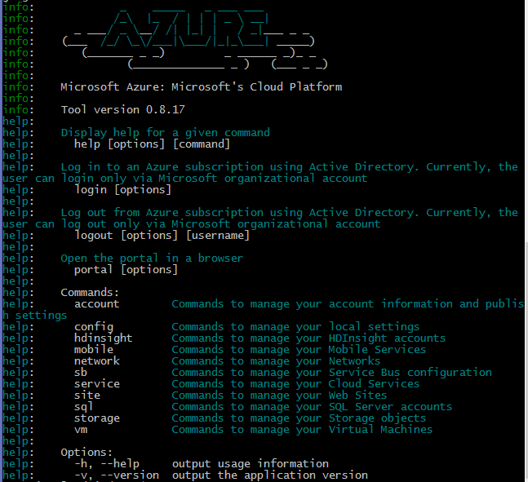
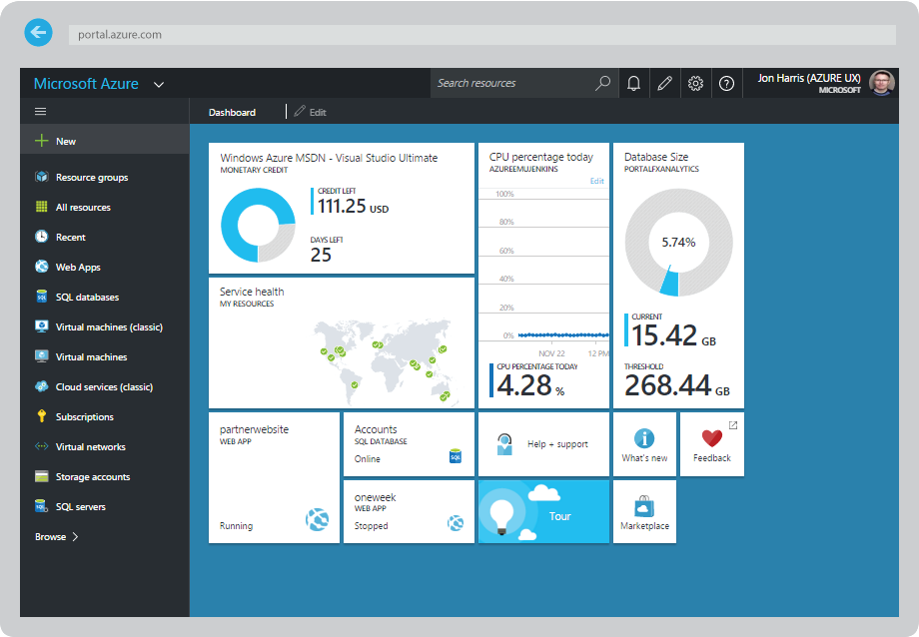
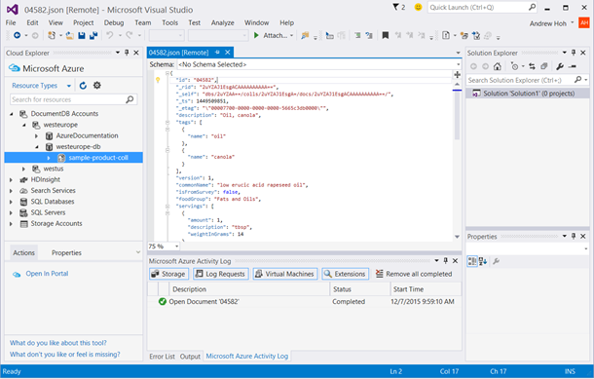
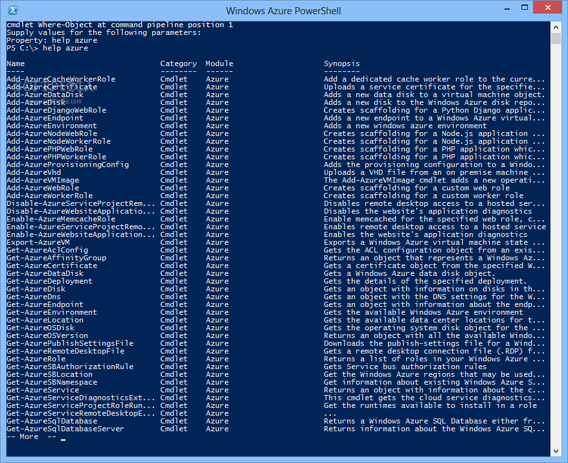
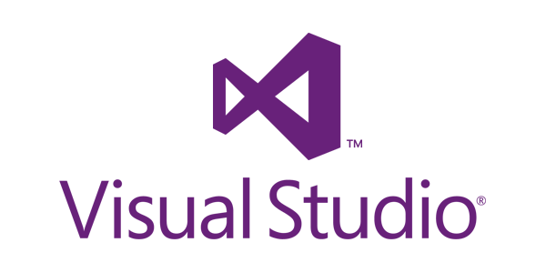
CLI, Portal, PowerShell, Visual Studio
Multiple ways to interact with Azure for any enterprise!
http://portal.azure.com
Linux Azure CLI Interface
http://aka.ms/azure-cli-2

Slide 17
Compute: IaaS, PaaS & Mobile Services

Slide 18
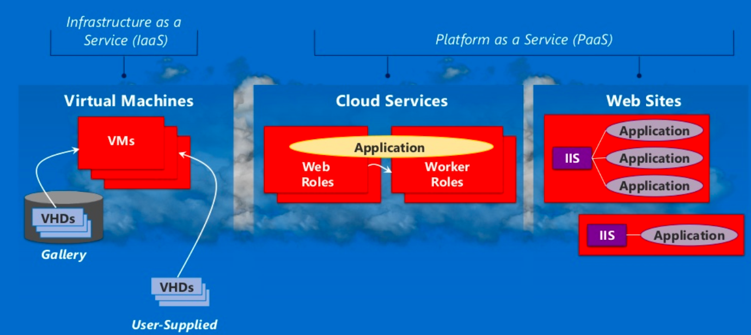
Azure Compute:

Slide 19
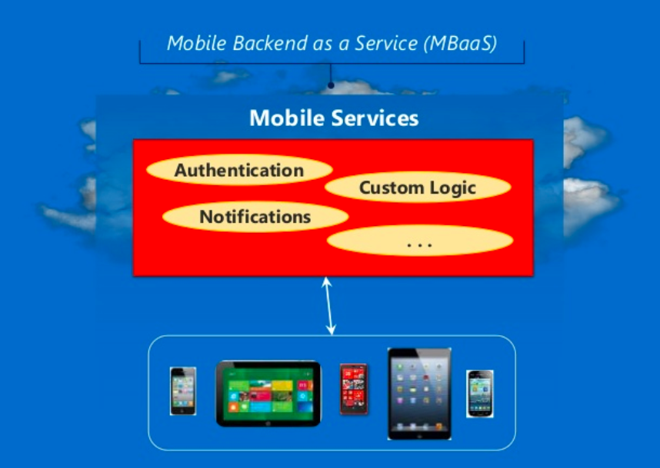
Azure Compute:

Slide 20
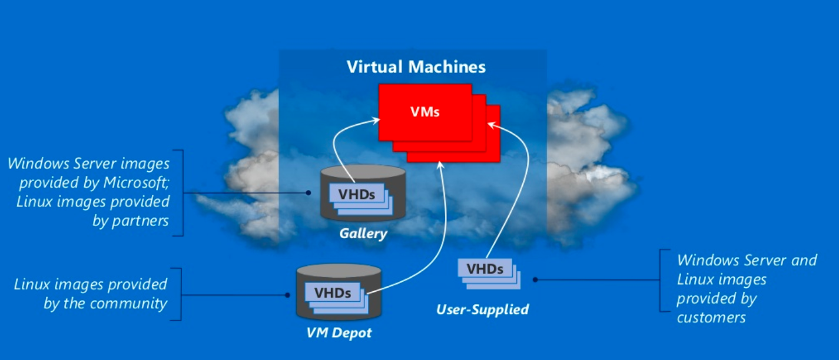
Azure Compute : IaaS

Slide 21
Linux Images:
Canonical UBUNTU
Oracle Linux
SUSE Linux Enterprise
OpenSUSE Linux
CENTOS by Open Logic
Notes:
Microsoft provides forum based support for all open source platforms today
Canonical Ubuntu – also available with pre-installed puppet enterprise from puppet labs.

Slide 22
Management with Puppet and Chef
Windows VM's
Linux VM's
Puppet Console
Chef Management Console

Slide 23
Linux images on Azure
Linux distributions
Images also includes other software
Notes:
The Linux images in the gallery just provides the OS
Linux distributions on other platforms like Debian are also available on azure.
Images also includes other softwares like wordpress

Slide 24
Pricing Comparison
Windows Server
Linux Server
Small A1 (1 Core, 1.75 GB) | $0.09 per hour
Medium A2 (2 Cores, 3.5 GB) | $0.18 per hour
Large A3 (4 Cores, 7 GB) | $0.36 per hour
Extra Large A4 (8 Cores, 14 GB) | $0.72 per hour
Memory Intensive A5 (2 Cores, 14 GB) | $0.33 per hour
Memory Intensive A6 (4 Cores, 28 GB) | $0.66 per hour
Memory Intensive A7 (8 Cores, 56 GB) | $1.32 per hour
Small A1 (1 Core, 1.75 GB) | $0.06 per hour
Medium A2 (2 Cores, 3.5 GB) | $0.12 per hour
Large A3 (4 Cores, 7 GB) | $0.24 per hour
Extra Large A4 (8 Cores, 14 GB) | $0.48 per hour
Memory Intensive A5 (2 Cores, 14 GB) | $0.25 per hour
Memory Intensive A6 (4 Cores, 28 GB) | $0.50 per hour
Memory Intensive A7 (8 Cores, 56 GB) | $1.00 per hour
Notes:
Standard pay as you go pricing
Linux is as much as 1/3 cheaper than windows server

Slide 25
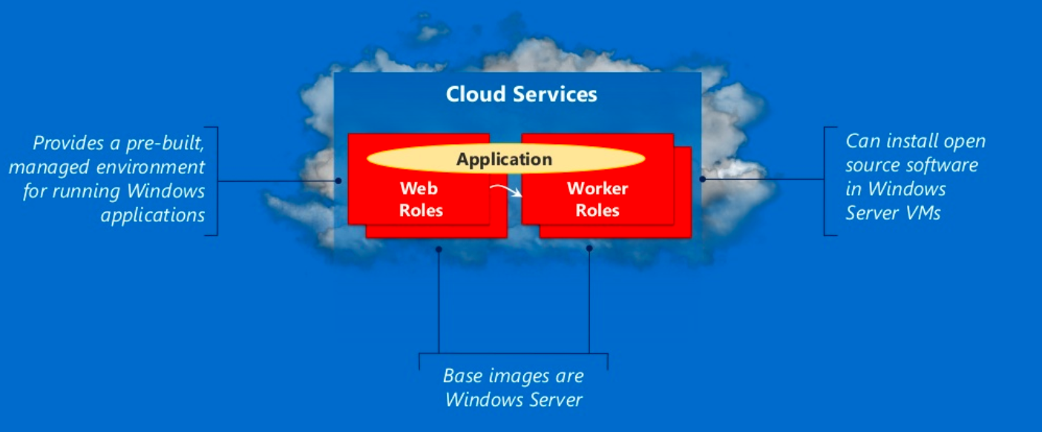
Azure Compute : PaaS

Slide 26
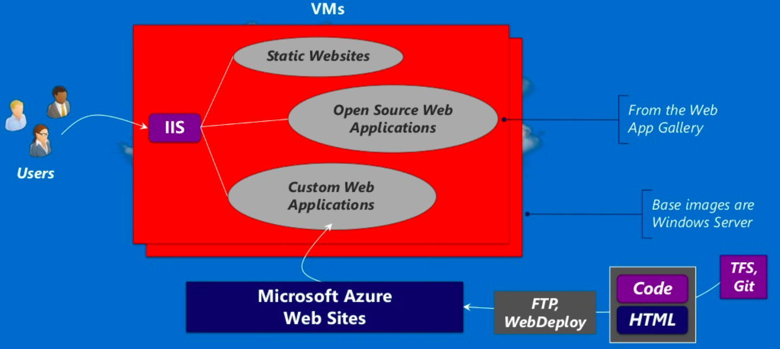
Azure Compute – PaaS - WebApps

Slide 27


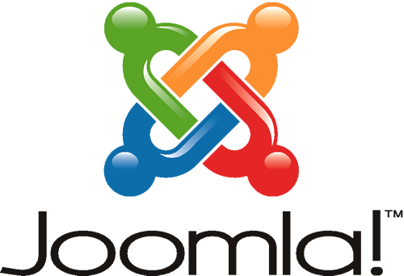
Azure Web Sites:
Applications | What it provides | Technology Foundation
Wordpress | Content Management System and Blogging | PHP/MySQL
Joomla | Content Management System | PHP/MySQL (and others)
Media Wiki | Wiki package | PHP/MySQL (and others)
Apache Tomcat | Web Server (or) Servlet Container | Java
Express | Web Framework | Javascript / Node.js

Slide 28
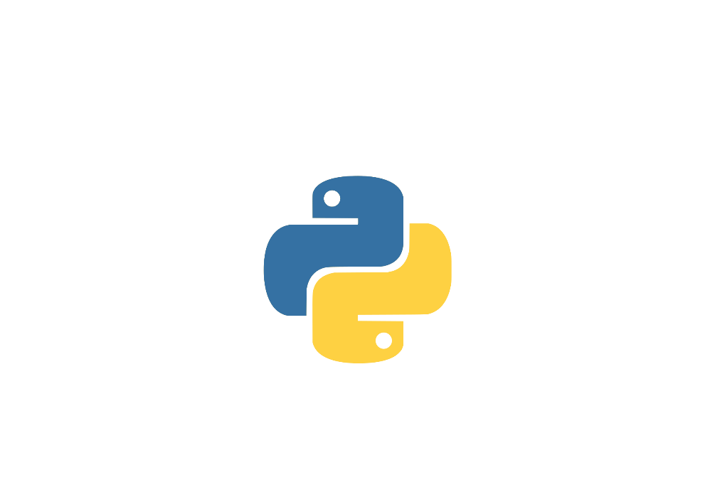

Supported Open Source Web Developments
Node.js
.
.
Notes:
PHP – Scripting language and environment for web development
Node.js - environment for web development with javascript
Python – general purpose dynamic programming language.
Note - .net and java applications are also supported.

Slide 29
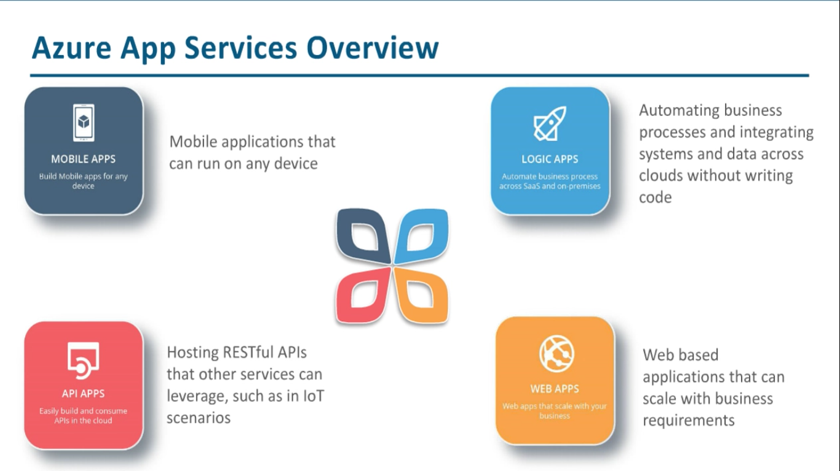

Slide 30
Data
SQL
NoSQL
Big Data Analytics

Slide 31
Azure with Open Source:
 | Operational Data | Analytical Data
NoSQL Technologies | Tables, Redis Cache Cassandra, HBase, etc., MongoDB Neo4J, etc., | Big Data Analytics – HDInsight, Hadoop
SQL Technologies | SQL Database, SQL Server, Oracle, MySQL, etc., | Relational Reporting & Relational Analytics
Notes:
Provided by Microsoft Azure – Runs in MS Azure VM's – Runs in MS Azure Virtual Machines and its open source

Slide 32
Operational NoSQL Databases
Example Technologies | What it provides?? | Example Use Cases
Redis – Azure Tables | Fast access to large amounts of simply structured data | Online shopping cart
Cassandra, HBase | Fast access to large amounts of more structured data | A table storing web pages
MongoDB | Scalable store for JSON documents | Persistent store for Node.js application
Notes:
Provided by Microsoft Azure – Runs in MS Azure VM's – Runs in MS Azure Virtual Machines and its open source

Slide 33


History of UNIX/Linux
UNIX was conceived by Ken Thompson and Dennis Ritchie from AT&T Bell Labs in 1969
Common UNIX derivatives include: SCO, IRIX, Solaris, AIX, HP/UX, BSD
Linux was created by Finnish software engineer Linus Torvalds in 1991
Made from a collection of open source software based on the Linux kernel which Torvalds developed
Linux is driven by community contributions which are merged into upstream “projects” and provided to users. Features are created based on need.

Slide 34
Common OSS/Linux Terms
Kernel – The core of the Linux operating system
Distribution (Distro) – A variant of the Linux operating system
Command-Line/Shell – The terminal window which commands are executed within
Daemon – A running service on a Linux server, httpd would be the web server
X-Windows (or X) – A graphical user interface to interact with & run applications
RPM – A package manager that provides for the install / removal / tracking of software
Fork – When a distribution is duplicated and changed to produce a new distribution
Package – An archive of software; Most apps on a host are installed via packages
GNU – Acronym for GNU’s Not Unix
GPL – The GNU GPL, or General Public License, is a free software license which guarantees end users the freedom to run, study, share and modify software
SSH – Secure Shell – Allows connections to other Linux servers via an encrypted tunnel

Slide 35

Distributions are a lot like Genealogy
Hundreds of distributions
https://en.wikipedia.org/wiki/List_of_Linux_distributions
Linux builds are based on a number of “Major” distributions
Debian (Knoppix, CentOS, Android, Linux Mint, Raspbian)
Gentoo (Chromium OS, CoreOS)
Pacman (Arch Linux)
RPM (Red Hat Linux, Red Hat Enterprise Linux, Fedora, Caldera, Oracle Linux)
Slackware (SuSE, Frugalware,
TUX the penguin got his name from “Torvalds’ UniX”

Slide 36
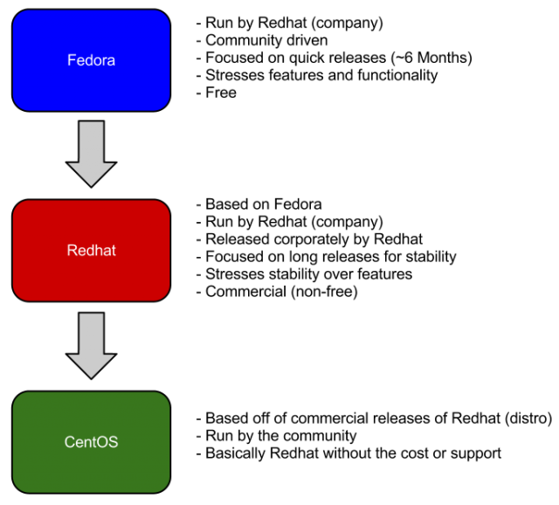
Commercial vs Community
Community projects have very quick release cycles
Typically bleeding edge technology and what will be seen in future commercial releases
Application vendors are unable to create software certified against a community project
Enterprise Linux products have much longer release cycle
Users pay for the support; Not the software

Slide 37
Red Hat Enterprise Linux forks from Fedora (Core)
Release | Codename | Release Date | Based on
Red Hat Linux 6.2E | Zoot | 2000-03-27 | Red Hat Linux 6.2
Red Hat Enterprise Linux 2.1 | Pensacola (AS)/ Panama (ES) | 2002-03-26 (AS) | Red Hat Linux 7.2
Red Hat Enterprise Linux 3 | Taroon | 2003-10-22 | Red Hat Linux 9
Red Hat Enterprise Linux 4 | Nahant | 2005-02-15 | Fedora Core 3
Red Hat Enterprise Linux 5 | Tikanga | 2007-03-14 | Fedora Core 6
Red Hat Enterprise Linux 6 | Santiago | 2010-11-10 | Mix of Fedora 12 Fedora 13 and several modifications
Red Hat Enterprise Linux 7 | Maipo | 2014-06-10 | Primarily Fedora 19 with several changes from 20 and later

Slide 38
What is / isn’t Open Source ?
Open Source
Source code freely available
Contributions can be made to the source code and submitted “upstream”
Distributed under licenses such as LGPL, GNU, MIT, etc.
Many licenses exist with varying degrees of restrictions.
Typically more secure due to community contributions
Closed Source
Source code not available
Software development is at the discretion of the application vendor
Software is copyrighted and licenses prohibit distribution
Software patches typically longer to distribute
Typically more profitable for vendors
https://opensource.org/licenses

Slide 39

What is ‘root’ ?
The ‘root’ user on any Linux system is used for administering the system
Equal to Windows “Administrator” account
Has complete access to the system, user home directories, service control, priorities, software managers, mail, etc.
Due to the “power” present in the “root” account, most Linux system administrators only use it to make necessary changes to a system that require elevated privileges
Administrators will typically create a login for themselves, for example, “bob” and when they require elevated permissions will “substitute user” or “su” to the root account, perform necessary actions, and then resume their original login shell

Slide 40
Creating a CentOS VM using Cloud-Shell in Azure Portal
Create and Start the Virtual Machine
az group create -n lfcs -l eastus2 -o table
az vm create -g lfcs -n lfcs --image OpenLogic:CentOS-LVM:7-LVM:7.5.20180524 --authentication-type password --storage-sku Standard_LRS --size Standard_A3 --admin-username mohd -o table

Slide 41
Shut down your CentOS VM when it isn’t in use!
The CentOS virtual machine created makes use of the CentOS Pay-As-You-Go VM image in the Azure Marketplace. In order to avoid large consumption charges, shut it down when it is not in use.
To stop the Azure CentOS VM from the Windows 10 bash shell:
az vm stop -–resource-group LinuxLFCSPrep -–name CentOSDemo
az vm deallocate -–resource-group LinuxLFCSPrep -–name CentOSDemo (You will lose your public IP address!)
To start the Azure CentOS VM from the Windows 10 bash shell:
az vm start -–resource-group LinuxLFCSPrep -–name CentOSDemo
az vm list-ip-address (Because deallocating the VM removed the public IP, this will determine the new IP)
To delete the Azure RHEL VM from the Windows 10 bash shell:
az vm delete -–resource-group LinuxLFCSPrep -–name CentOSDemo
azure group delete LinuxLFCSPrep

Slide 42
Linux 1. Create and Manage Linux VMs with the Azure CLI 2.0 in Azure Cloud Shell
You learn how to:
Create and connect to a VM
Select and use VM images
View and use specific VM sizes
Resize a VM
View and understand VM state
[Optional] Manage Disks: https://docs.microsoft.com/en-us/azure/virtual-machines/linux/tutorial-manage-disks
Important Notes
Use your Initials1514 or other unique code for variables to prevent any duplicate public urls e.g. (lowercase):
dan1514vm for “myVM”
Stop and Deallocate or Delete resources when done with ALL labs (you can reuse these machines for the next few labs but do not forget to go back after done with labs)
https://docs.microsoft.com/en-us/azure/virtual-machines/linux/tutorial-manage-vm
Notes:
High level demonstration steps
From the classroom VM, start Internet Explorer and browse to https://github.com/Azure /azure-quickstart-templates/tree/master/101-vm-simple-windows.
On the Very simple deployment of a Windows VM page, click Deploy to Azure.
On the Custom deployment blade, specify the following:
Subscription: Your subscription
Resource group: Create new
New resource group name: 10979D03-DemoRG03
Location: Azure region closest to the classroom location
Admin Username: Student
Admin Password: Pa55w.rd1234
Dns Label Prefix: Unique string consisting of lower-case letters and digits
Windows OS Version: 2016-Datacenter
Click I agree to the terms and conditions stated above.
Select the Pin to dashboard check box.
Click Purchase.
Note the Deployment started message in the notification area at the top of the page.
Do not wait for the deployment to complete. Continue with the next topic.

